Slide 1
Nigerian Disease Death Analysis
File created on: 10/31/2022 2:25:47 PM

Slide 2
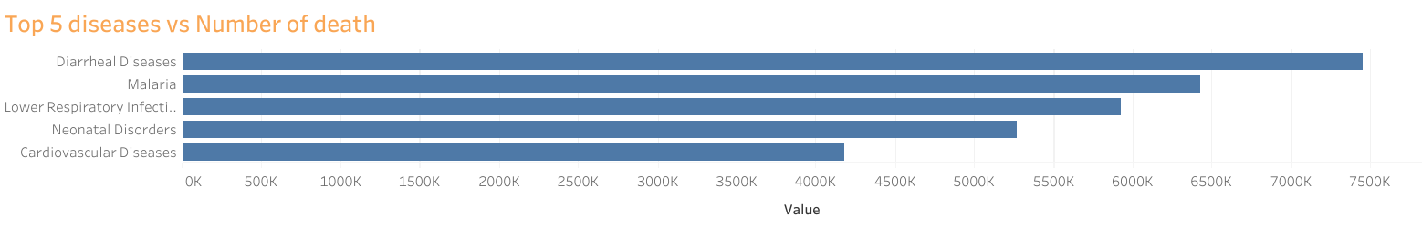

Slide 3
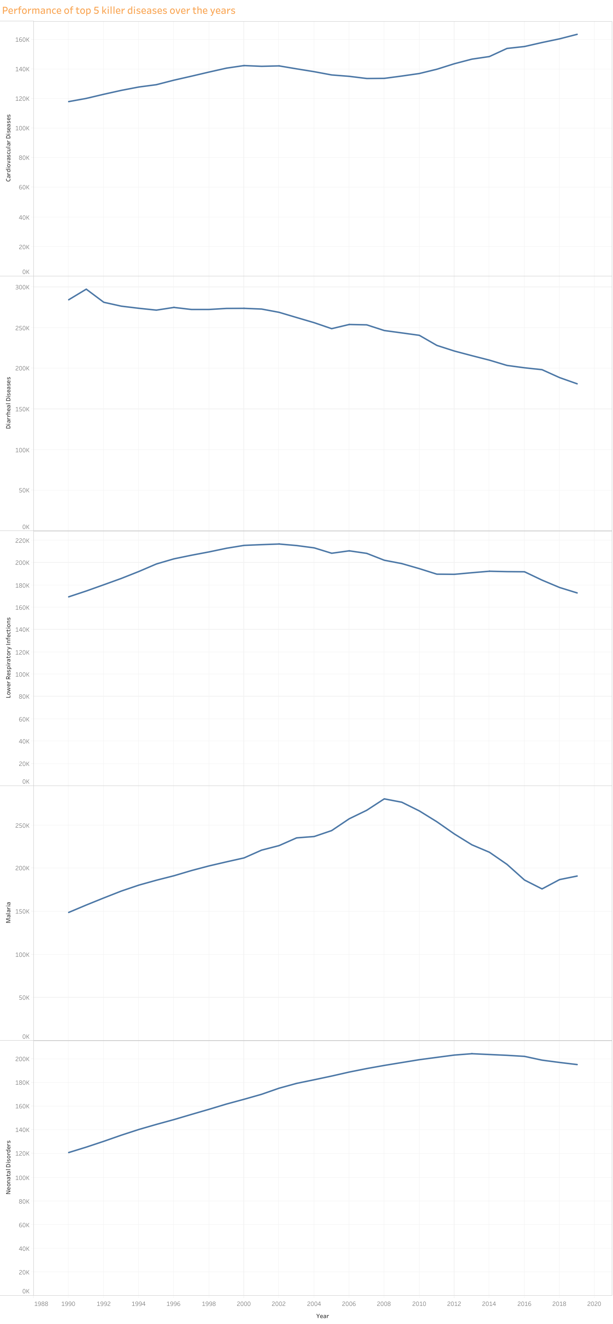

Slide 4
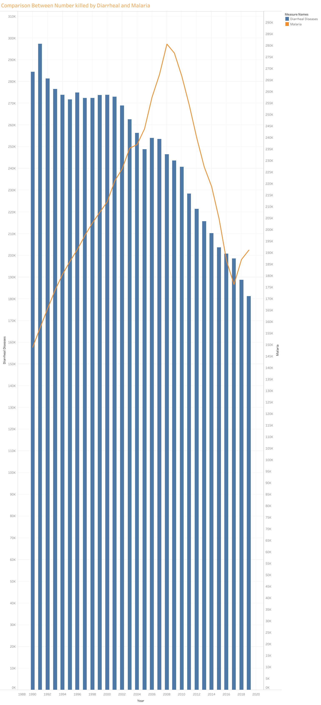

Slide 5
